Slide 1
The Customer and the BA
3

Slide 2
Contents
The expectation gap
Stakeholders, Customers and Users
Rights of customers
Responsibilities of customers
Decision making and agreement
The business analyst
The BA tasks, skills and knowledge

Slide 3
The expectation gap
Without adequate customer involvement, an expectation gap develops
a gulf between what customers really need and what developers deliver based on what they heard at the beginning of the project
The best way to minimize it is to arrange frequent contact points with suitable customer representatives
in the form of interviews, conversations, requirements reviews, user interface design walkthroughs, prototype evaluations, user feedback on small software releases etc.

Slide 4
Stakeholders, Customers and Users
A stakeholder is a person, group, or organization that is actively involved in a project, is affected by its process or outcome, or can influence its process or outcome.
Can be internal or external to the project team and to the developing organization
A customer is an individual or organization that derives either direct or indirect benefit from a product.
Customers are a subset of stakeholders
Some stakeholders are not customers e.g. legal staff, compliance auditors, suppliers, …
A user (or end user) is someone who will actually use the product, either directly or indirectly
Users are a subset of customers
Direct users will operate the product hands-on
Indirect users might receive outputs from the system without touching it themselves
e.g. a warehouse manager who receives an automatic report of daily warehouse activities by email.

Slide 5
Potential Stakeholders
Stakeholder analysis is an important part of requirements development
Can you identify stakeholders, customers and users?

Slide 6
Customer-Developer partnership
Excellent requirements result from effective collaboration between developers and customers – a partnership
The business analyst typically is the point person who has to forge this collaborative partnership
This partnership can be based on a set of rights and responsibilities
A sample is given that can be modified to suit the local culture, organization etc.
The word “you” in the rights and responsibilities refers to a customer for a software development project.
The Requirements Bill of Rights for Software Customers lists some expectations that customers can hold regarding their interactions with BAs and developers
Can be seen as responsibilities of the BAs or software developers
The Requirements Bill of Responsibilities for Software Customers lists some responsibilities that the customer has to BAs and developers
Can be seen as rights of the BAs or software developers

Slide 7
Requirements bill of rights for software customers

Slide 8
Requirements bill of responsibilities for software customers

Slide 9
Identifying decision makers
There can be hundreds of decisions to make on software projects.
You might need to resolve some conflict, accept (or reject) a proposed change, or approve a set of requirements for a specific release.
Early in your project, determine who the requirements decision makers will be and how they will make decisions.
The decision-making group needs to identify …
a decision leader
a decision rule or decision making process
Note
There is no globally correct or appropriate decision rule.
A single decision rule won’t work in every situation, so the group must establish guidelines so they know when to vote, when to reach consensus, when to delegate, and so on.

Slide 10
Reaching agreement on requirements
Some people “sign off” on requirements without reading them
“I was handed a piece of paper with my name on it, so I signed on the line above my name because otherwise the developers wouldn’t start coding.”
Some view sign-off as a way to freeze the requirements
“But you signed off on these requirements, so that’s what we’re building. If you wanted something else, you should have said so.”
Both of these attitudes ignore the reality that it’s impossible to know all the requirements early in the project and that requirements will undoubtedly change over time.
Approving a set of requirements is an appropriate action that brings closure to some stage of requirements development; but the participants have to agree on precisely what they’re saying with their signatures.

Slide 11

Reaching agreement on requirements
Some organizations put text like this right on the signature page, so the requirement approvers know exactly what sign-off means in their world.
“I agree that this set of requirements represents our best understanding of the requirements for the next portion of this project and that the solution described will meet our needs as we understand them today. I agree to make future changes in this baseline through the project’s defined change process. I realize that changes might require us to renegotiate cost, resource, and schedule commitments.”

Slide 12
Working with non-agreement
It can be hard to achieve sign-off from all the relevant stakeholders.
Barriers include logistics, busy schedules, and people who are reluctant to commit and be held accountable later.
If agreement of all concerned people has not been achieved, its better to move forward cautiously instead of getting trapped in analysis paralysis
Document the fact that certain stakeholders didn’t sign off on the requirements in your risk list, along with the likely impact of some of the requirements being missing or wrong.
Follow up with these people as part of risk management.
In a positive manner, mention that you recognize that they have not yet approved the requirements but that the project is still moving forward with those requirements as a baseline so as to not impede progress.
Let them know that, if they want to change things, there’s a process in place to do that.

Slide 13
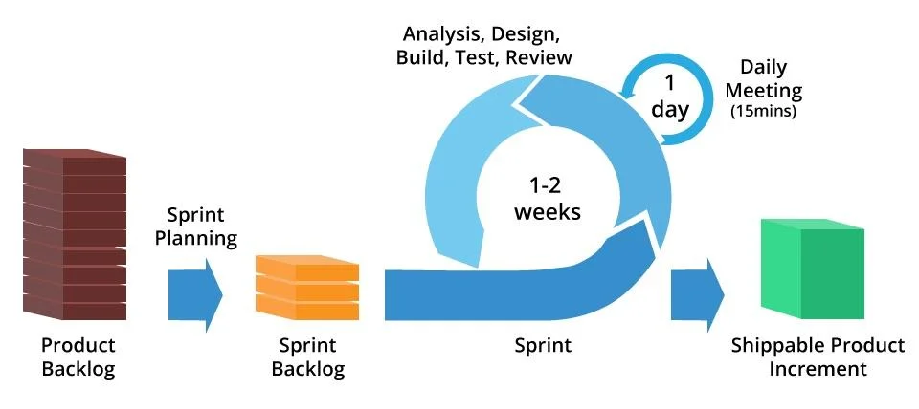
Requirements on agile projects
Usually agile projects do not include a formal sign-off action.
Agile projects generally maintain requirements in the form of user stories in a product backlog.
The product owner and the team reach agreement on what stories will be developed in the next iteration in a planning session.
The set of stories is chosen based on their priority and the team’s velocity (productivity).
Requested changes that come in are considered for future iterations.
There’s no attempt on an agile project to achieve stakeholder approval on the full scope of requirements for the project up front.
The full set of functionality is identified over time, although the vision and other business requirements do need to be established at the outset.

Slide 14
The business analyst
The business analyst is the individual who has the primary responsibility to elicit, analyze, document, and validate the needs of the project stakeholders.
The analyst serves as the principal interpreter through which requirements flow between the customer group and the software development team
many other communication pathways are also used
The BA plays a central role in collecting and disseminating product information
The project manager takes the lead in communicating project information

Slide 15
The business analyst

Slide 16

The business analyst role
Business analyst is a project role, not necessarily a job title.
aka requirements analyst, systems analyst, requirements engineer, requirements manager, application analyst, business systems analyst, IT business analyst, and simply analyst.
One or more dedicated specialists could perform the role on a given project or it could be assigned to team members who also perform other project functions

Slide 17
The BA tasks
The analyst must first understand the business objectives for the project and then define user, functional, and quality requirements that allow teams to estimate and plan the project and to design, build, and verify the product.
The BA is also a leader and a communicator, turning vague customer notions into clear specifications that guide the software team’s work.

Slide 18
The typical BA tasks
Define business requirements
Plan the requirements approach
Identify project stakeholders and user classes
Elicit requirements
Analyze requirements
Document requirements
Communicate requirements
Lead requirements validation
Facilitate requirements prioritization
Manage requirements

Slide 19
Essential BA skills
Listening skills
Interviewing and questioning skills
Thinking on your feet
Analytical skills
Systems thinking skills
Learning skills
Facilitation skills
Leadership skills
Observational skills
Communication skills
Organizational skills
Modeling skills
Interpersonal skills
Creativity

Slide 20
Essential analyst knowledge
BAs need a breadth of knowledge, much of which is gained through experience.
They need to understand contemporary requirements engineering practices and how to apply them in the context of various software development life cycles.
An analyst needs to thread requirements development and management activities through the entire project life span.
An analyst with a sound understanding of project management, development life cycles, risk management, and quality engineering can help prevent requirements issues from torpedoing the project.
BAs benefit from a basic level of knowledge about the architecture and operating environment, so that they can engage in technical conversations about priorities and non-functional requirements.
Knowledge of the business, the industry, and the organization are powerful assets for an effective BA.
The business-savvy analyst can minimize miscommunications with users. Analysts who understand the organization and business domains often detect unstated assumptions and implicit requirements.

Slide 21
Well-rounded BA
No matter what his background, a creative business analyst can apply it to enhance his effectiveness.
The analyst needs to gain the knowledge and skills he is lacking, build on any past experiences, and practice performing the BA tasks to become more proficient.
All of these help create the well-rounded BA

Slide 22
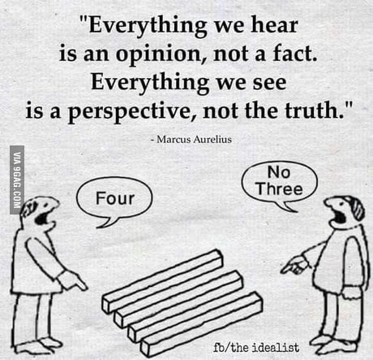

Slide 23
Summary
The expectation gap
Stakeholders, Customers and Users
Rights of customers
Responsibilities of customers
Decision making and agreement
The business analyst
The BA tasks, skills and knowledge

